Slide 1
University of Johannesburg
Member Presentation – February 2018

Slide 2
Your Retirement Fund

Slide 3
The University of Johannesburg Pension Fund - Structure
University of Johannesburg Pension Fund
Stand Alone Fund
Investment Committee, Board of Trustees and Principal Officer
Governance
- Investment Committee and Board of Trustees
- Time
- Resource
- Commitment
- Knowledge, ability and training
- Fiduciary responsibilities
- Regulatory and Reporting
- Ongoing monitoring
- Internal Policies and Structure
Investment Strategy Considerations
- Asset Allocation
- Life-stage methodology
- Specialist vs. Balanced methodologies
- Active vs. Passive
- Member Choice
- Pooled and/or Segregated Mandates
- Single vs. Multi-managers
- Investment Platform
Risk Benefits
Costs
Communication
Legislation (Default Strategy, In-fund Preservation & Annuities,
Post-retirement involvement.

Slide 4
Member Investment Choice Framework

Slide 5
Considerations for Members
Investment horizon - i.e. duration of membership of the Fund
  Retirement age
  Contributions
  Investment returns
  Savings outside of the Fund
  Tolerance for investment risk
  Ability and / or willingness to make one’s own investment decisions / choice
  Post – retirement investment strategy

Slide 6
LifeStage Model – Default / Trustee Choice
Based on the assumption that younger members can accept
more risk due to their long investment time horizon
As a member ages, his/her risk is reduced by reducing their
equity exposure
Portfolio suitable for members who do not wish to make their own
investment choice
Trustees responsible for selecting and monitoring the investment managers and portfolios, as well as the structure of the Lifestage model
Default portfolio is the Lifestage Portfolio – represents Trustees’ best investment view
Portfolio restructuring in terms of member’s age takes place automatically on an annual basis
Alignment with post – retirement investment strategy

Slide 7
Risk-Return Profile
Wealth Creation
Shari’ah Compliant
Expected Return
Wealth Preservation
Capital Protection
Capital Guarantee
Money Market
Expected Risk

Slide 8
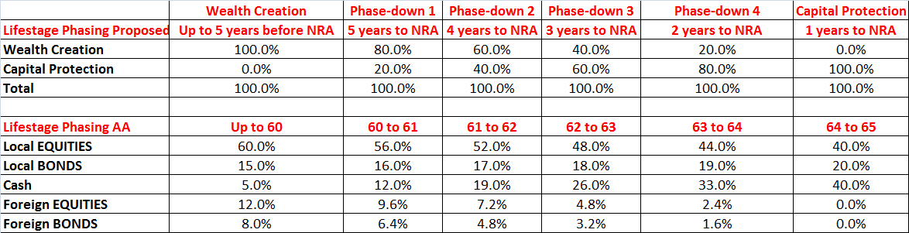
LifeStage Model - Current
In 2017, the Board of Trustees have approved changes to the current investment choice framework

Slide 9
Annuity Targeting Portfolios - Considerations
A member’s retirement investment horizon does not end at age 65, but will continue into retirement as long as they receive a monthly pension
Therefore, it is important to also match a member’s pre-retirement investment strategy to what a member plans to do with their benefit after retirement
Members in a retirement fund can and do have very different needs, both before AND after retiring, therefore a member choice framework must take cognizance of this fact
In summary, members can make the following decisions at the point of retirement:
  Invest in a living annuity with a high allocation to equities
  Invest in a living annuity with a low- to- medium allocation to equities
  Take their retirement benefit in cash (in whole or in part, depending on the value)
  Invest in a life, with-profit or inflation-linked annuity

Slide 10
Annuity Targeting Portfolios - Changes
The following additional portfolio channels will be made available as member-choice
options:
High-equity living Annuity
  Members will remain invested in the Wealth Creation Portfolio
Cash (At Retirement)
  Members will transition into the Money Market Portfolio
Capital Guarantee
  Members will transition into the Capital Guarantee Portfolio
Life, With-Profit & Inflation-linked Annuity
  Members will transition into a new portfolio option called the Protector Portfolio
5. The Life-stage Portfolio will remain the default portfolio, and is best suited for a member who wishes to purchase a low equity living annuity at retirement

Slide 11
Life, with-profit and inflation-linked annuities - Protector Portfolio
For members in the pre-retirement phase who will be purchasing a life, with-profit or inflation-linked annuity at the point of retirement, the Protector Portfolio has been added. It has three integrated objectives:
Protect the expected income replacement value of a member’s accumulated retirement savings for retirement
Protect the capital value of a member’s retirement savings over 24 month periods
Maximise real returns (returns less consumer inflation) whilst achieving objectives 1 and 2

Slide 12
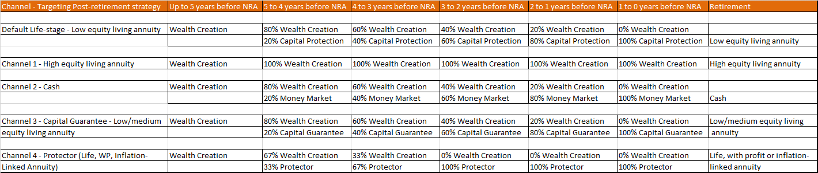
Annuity Targeting Channels
In Summary, the available channels to members are:
It is important to note that in each year where phasing down from one portfolio to another takes place, this will take place quarterly, i.e. there will be 4 phasing events that take place in each year
  Currently this takes place once per year
The implementation date for the Annuity channels is 1 April 2018

Slide 13
Member Advice Framework
The Trustees have put the following measures in place in order to ensure that members receive appropriate financial advice:
7 years prior to retirement
  Retirement planning workshop
  Members able to make a one-on-one appointment with a certified financial planner, to discuss their specific circumstances
5 years prior to retirement
  Second retirement planning workshop – option to elect pre-retirement portfolio
  Members able to make a one-on-one appointment with a certified financial planner, to discuss their specific circumstances
A certified financial planner will continue to visit each of the University’s campuses on a monthly basis, to meet with members on a one-on-one basis.
  Members are required to make an appointment in this regard

Slide 14
Member Choice Portfolios

Slide 15
Portfolio Options
Life Stage Model (Default)
Wealth Creation
Phase-down Portfolios 1 – 4
Capital Protection (implicit capital preservation)
Capital Guarantee Portfolio (explicit capital protection)
Money Market Portfolio
Shari’ah compliant portfolio
Protector portfolio
Life Stage Channels
    High Equity Channel
    Low-Medium Equity Channel
    Life Annuity Targeting Channel
    Cash Channel
    Capital Protection Channel

Slide 16
Wealth Creation
Balanced portfolio with flexible asset allocation
Aims to achieve inflation + 6% in the long-term
Potentially higher risk as equity exposure can range from 45% to 75%
Ideal for members with long-term investment horizon

Slide 17
Wealth Preservation (Phase-down 3 Portfolio)
Combination of positive-return portfolio (60%) with exposure to higher risk balanced portfolio (40%)
Aims to achieve inflation + 4.5% in the medium to long-term
Aims to preserve wealth in real terms while maintaining exposure to growth assets
Lower equity exposure and risk than Wealth Creation

Slide 18
Capital Protection
Aims to minimize the risk of negative returns over the short-term
A positive-return portfolio with no explicit guarantees provided
Aims to achieve inflation + 4% over 3 years
More “aggressive” portfolios should outperform this portfolio over long-term

Slide 19
Money Market
100% money market instruments
Lowest risk profile
Suitable for investors who have a low appetite for risk and investors with short-term investment horizons
Least likely portfolio to outperform inflation in the long-term

Slide 20
Capital Guarantee Portfolio
Smooth-bonus portfolio (underlying assets are diversified with exposure to all asset classes)
Objective to achieve inflation + 3.5% over longer term
Fixed guarantee on capital, contributions and declared positive investment returns (on benefit payments and other specified events)
Returns declared monthly in advance, once declared cannot be taken away
Switch at book value (limited to 10% of assets)
Suitable for risk-averse investors (close to retirement and who wish to avoid volatility of full market-linked investments)

Slide 21
Shari’ah Portfolio
A Shari’ah Compliant Portfolio that is also compliant with Regulation 28 of the Pension Funds Act
Balanced Fund with exposure to equity, Islamic bonds (Sukuks) and a small allocation to cash
Equity exposure may be as high as 65% of the portfolio
Aims to give investment returns comparable to a traditional balanced portfolio

Slide 22
Protector Portfolio
Multi-asset specialist portfolio, with a higher allocation to fixed income investments (government nominal bonds, inflation-linked bonds and property)
Protect the expected income replacement value of a member’s accumulated retirement savings for retirement
Protect the capital value of a member’s retirement savings over 24 month periods
Maximise real returns (returns less consumer inflation) whilst achieving objectives 1 and 2

Slide 23
Portfolio Performance

Slide 24
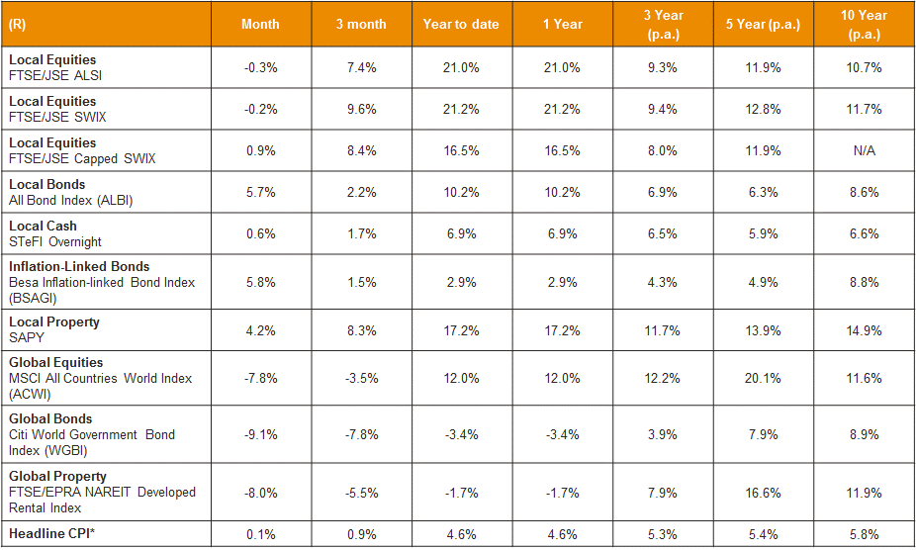
Asset class performance - 31 December 2017

Slide 25
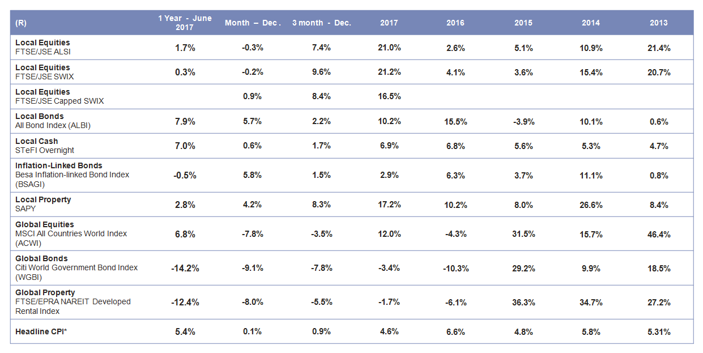
Calendar Year Asset Class Returns – 31 December 2017

Slide 26
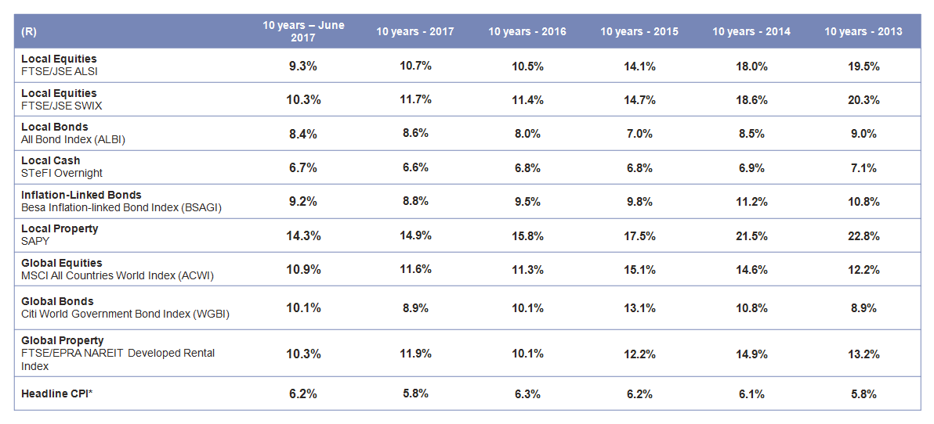
Multi-period Asset Class Returns – 10 years to 31 December 2017

Slide 27
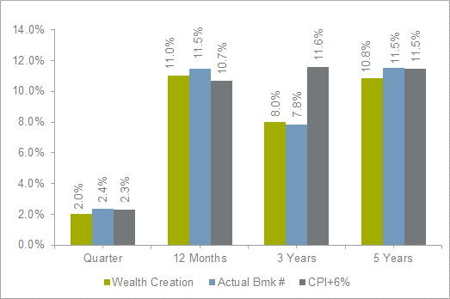
Wealth Creation (Net)
Source: Alexander Forbes Asset Consultants

Slide 28
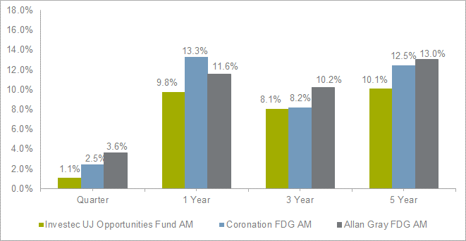
Wealth Creation (Net)
Source: Alexander Forbes Asset Consultants

Slide 29
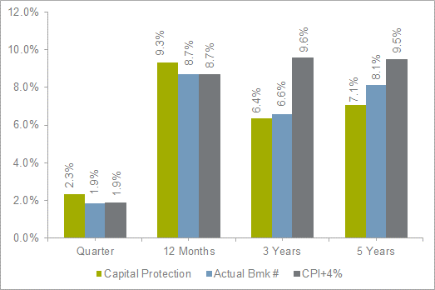
Capital Protection Portfolio (Net)
Source: Alexander Forbes Asset Consultants

Slide 30
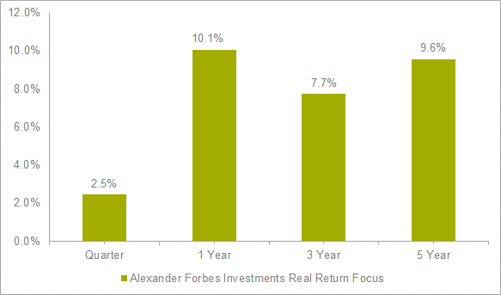
Capital Protection Portfolio (Net)
Source: Alexander Forbes Asset Consultants

Slide 31
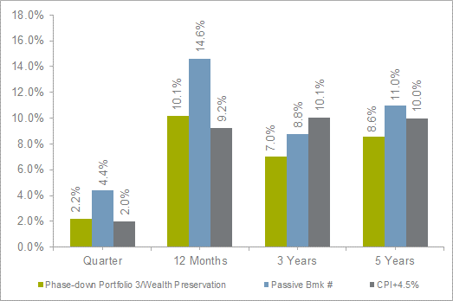
Phase-down Portfolio 3/Wealth Preservation (Net)
Source: Alexander Forbes Asset Consultants

Slide 32
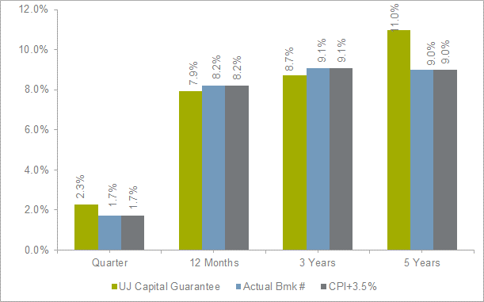
Capital Guarantee Portfolio (Net)
Source: Alexander Forbes Asset Consultants

Slide 33
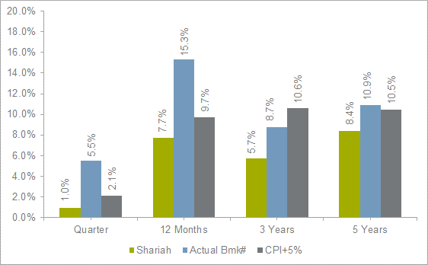
Shari’ah Portfolio (Net)
Source: Alexander Forbes Asset Consultants

Slide 34
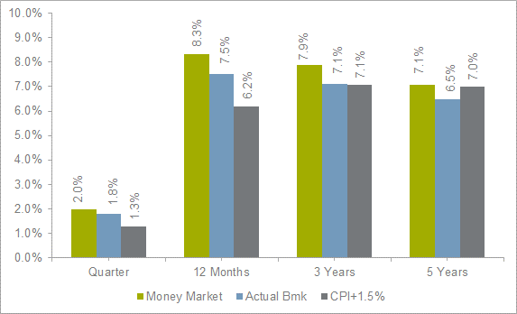
Money Market Portfolio (Net)
Source: Alexander Forbes Asset Consultants

Slide 35
Thank you
This document has been prepared for use by clients of the Alexander Forbes Group. Any other third party that is not a client of the Alexander Forbes Group and for whose specific use this document has not been supplied, must be aware that Alexander Forbes Group shall not be liable for any damage, loss or liability of any nature incurred by any third party and resulting from the information contained herein. The information contained herein is supplied on an "as is" basis and has not been compiled to meet any third party’s individual requirements. It is the responsibility of any third party to satisfy himself or herself, prior to relying on this information that the contents meets the third party’s individual requirements.
Nothing in this document, when read in isolation and without professional advice, should be construed as solicitation, offer, advice, recommendation, or any other enticement to acquire or dispose of any financial product, advice or investment, or to engage in any financial transaction or investment. A third party should consult with an authorised financial advisor prior to making any financial decisions.
Alexander Forbes has taken all reasonable steps to ensure the quality and accuracy of the contents of this document and encourages all readers to report incorrect and untrue information, subject to the right of Alexander Forbes to determine, in its sole and absolute discretion, the contents of this document. Irrespective of the attempts by Alexander Forbes to ensure the correctness of this document, Alexander Forbes does not make any warranties or representations that the content will in all cases be true, correct or free from any errors. In particular, certain aspects of this document might rely on or be based on information supplied to Alexander Forbes by other persons or institutions. Alexander Forbes has attempted to ensure the accuracy of such information, but shall not be liable for any damage, loss or liability of any nature incurred by any party and resulting from the errors caused by incorrect information supplied to Alexander Forbes.

Slide 36
Wealth Creation (Net)
Source: Alexander Forbes Asset Consultants

Slide 37
Wealth Creation (Net)
Source: Alexander Forbes Asset Consultants

Slide 38
Capital Protection Portfolio (Net)
Source: Alexander Forbes Asset Consultants

Slide 39
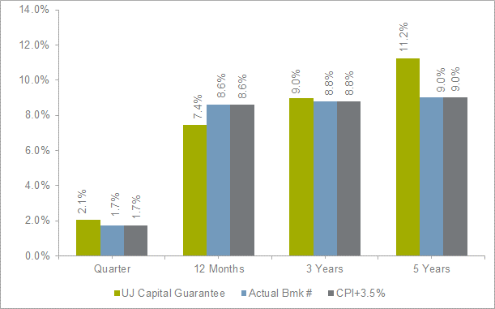
Capital Guarantee Portfolio (Net)
Source: Alexander Forbes Asset Consultants

Slide 40
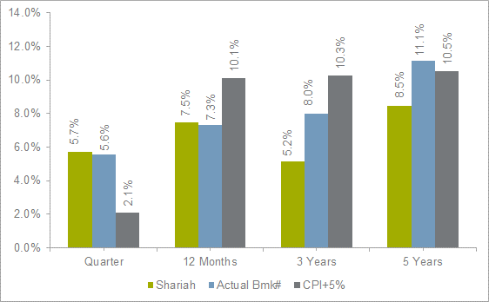
Shari’ah Portfolio (Net)
Source: Alexander Forbes Asset Consultants

Slide 41
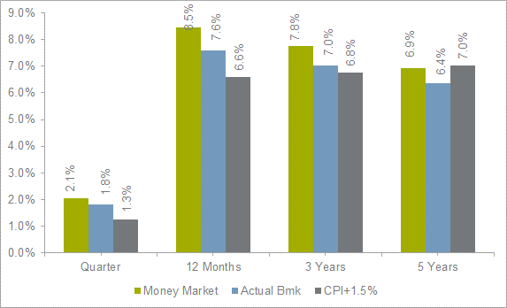
Money Market Portfolio (Net)
Source: Alexander Forbes Asset Consultants

Slide 42
Thank you
This document has been prepared for use by clients of the Alexander Forbes Group. Any other third party that is not a client of the Alexander Forbes Group and for whose specific use this document has not been supplied, must be aware that Alexander Forbes Group shall not be liable for any damage, loss or liability of any nature incurred by any third party and resulting from the information contained herein. The information contained herein is supplied on an "as is" basis and has not been compiled to meet any third party’s individual requirements. It is the responsibility of any third party to satisfy himself or herself, prior to relying on this information that the contents meets the third party’s individual requirements.
Nothing in this document, when read in isolation and without professional advice, should be construed as solicitation, offer, advice, recommendation, or any other enticement to acquire or dispose of any financial product, advice or investment, or to engage in any financial transaction or investment. A third party should consult with an authorised financial advisor prior to making any financial decisions.
Alexander Forbes has taken all reasonable steps to ensure the quality and accuracy of the contents of this document and encourages all readers to report incorrect and untrue information, subject to the right of Alexander Forbes to determine, in its sole and absolute discretion, the contents of this document. Irrespective of the attempts by Alexander Forbes to ensure the correctness of this document, Alexander Forbes does not make any warranties or representations that the content will in all cases be true, correct or free from any errors. In particular, certain aspects of this document might rely on or be based on information supplied to Alexander Forbes by other persons or institutions. Alexander Forbes has attempted to ensure the accuracy of such information, but shall not be liable for any damage, loss or liability of any nature incurred by any party and resulting from the errors caused by incorrect information supplied to Alexander Forbes.

